Slide 1









My Number Interactive Notebook
$$×$$
$$\frac{1}{2}$$
$$÷$$
$$+$$
$$−$$
$$\frac{3}{5}$$
$$7$$
Name
Class
Teacher
Term 1 Semester 1
$$5^{2}$$
$$\sqrt{9}$$
1

Slide 2
Contents
Glossary or Formula Page
Page
Date
Description
2
3

Slide 3
Tasks
24
7
30
Essential Question
Questions
Notes
Summary
10
11

Slide 4
24
7
30
Date
Scientific Notation Small
EQ – How is index notation used to write very small numbers?
11

Slide 5
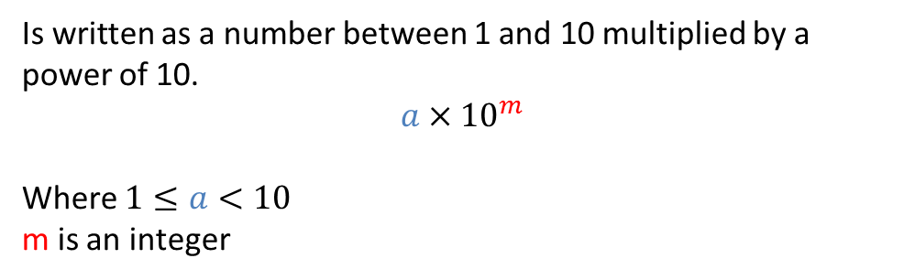
24
7
30
Date
Scientific Notation small numbers
EQ – How is index notation used to write very small numbers?
What is scientific notation?
Examples
Is written as a number between 1 and 10 multiplied by a power of 10.
$$a×{10}^{m}$$
Where $1≤a<10$
m is an integer
Write 0.0000073 in scientific notation.
11

Slide 6
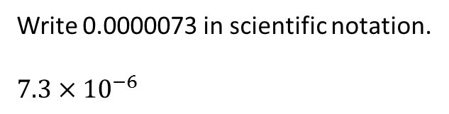
24
7
30
Date
Scientific Notation small numbers
EQ – How is index notation used to write very small numbers?
What is scientific notation?
Examples
Is written as a number between 1 and 10 multiplied by a power of 10.
$$a×{10}^{m}$$
Where $1≤a<10$
m is an integer
Write 0.0000073 in scientific notation.
$$7.3×{10}^{−6}$$
The number places the decimal point moves
11

Slide 7
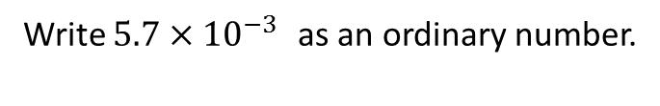
24
7
30
Date
Scientific Notation small numbers
EQ – How is index notation used to write very small numbers?
What is scientific notation?
Examples
Is written as a number between 1 and 10 multiplied by a power of 10.
$$a×{10}^{m}$$
Where $1≤a<10$
m is an integer
Write 0.0000073 in scientific notation.
$$7.3×{10}^{−6}$$
The number places the decimal point moves
Write $5.7×{10}^{−3 }$as an ordinary number.
11

Slide 8
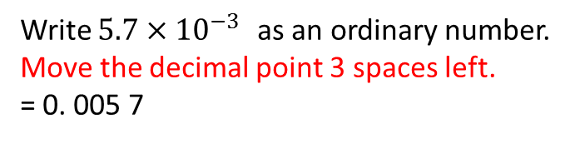
24
7
30
Date
Scientific Notation small numbers
EQ – How is index notation used to write very small numbers?
What is scientific notation?
Examples
Is written as a number between 1 and 10 multiplied by a power of 10.
$$a×{10}^{m}$$
Where $1≤a<10$
m is an integer
Write 0.0000073 in scientific notation.
$$7.3×{10}^{−6}$$
The number places the decimal point moves
Write $5.7×{10}^{−3 }$as an ordinary number.
Move the decimal point 3 spaces left.
= 0. 005 7
11

Slide 9
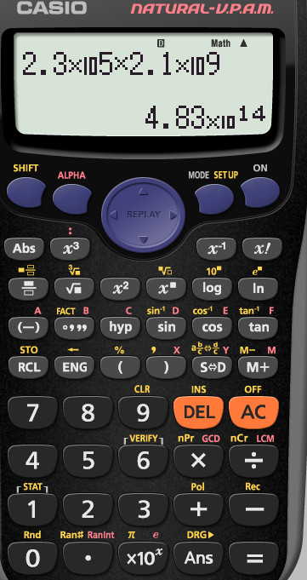
Some calculators use
EXP
Use for scientific notation

Slide 10
Task
Page 354-357
6-10
12 and 13

Slide 11
Notes Review
24, 7 ,30
Date
Title
Essential question
Notes complete
Notes complete with colour and diagrams
Questions completed
Contents page filed in
Formula page filled in

Slide 12
Homework
Review your notes and write a summary answering the essential question.

